Slide 1

Fraud Detection in Banking Data Using Machine Learning
Project batch No: A-6
PROJECT BY: PROJECT GUIDE:
TL: K.Sneha(21BQ1A6129) Mr . SK. Beeban Basha
TM1: B.Vamsi( 21BQ1A6111)
TM2: Sk.Sharmila( 21BQ1A6152)
TM3: S.Venkata SaiTeja(22BQ5A6107)

Slide 2
CONTENTS
Abstract
Introduction
Existing system
Tools
Proposed system
Objective
Applications
Execution
Conclusion

Slide 3
Abstract
Fraud detection in banking is a critical aspect of ensuring financial security, which significantly impacts customer trust and organizational outcomes.
Banking transactions generate vast amounts of data, but manually identifying fraudulent activities is time-consuming and prone to human errors.
The increasing demand for efficient detection systems has led to the exploration of automated solutions powered by machine learning.
This project aims to develop an automated fraud detection system for banking data using advanced machine learning techniques
The system integrates gradient boosting algorithms for feature extraction and classification, ensuring precise detection of fraudulent activities
The goal is to provide a reliable tool that enhances detection accuracy, reduces false positives, and assists in making timely decisions to mitigate fraud.

Slide 4
INTRODUCTION
The main purpose behind our project “FRAUD DETECTION IN BANKING DATA USING MACHINE LEARNING” is to address the challenges of accurately identifying fraudulent transactions in banking datasets.
Despite advancements in financial technology, manual fraud detection remains time-consuming and prone to errors.
With the rise of machine learning techniques, we believe that this issue can be effectively tackled by leveraging algorithms for classification and anomaly detection tasks.
Our project aims to systematically explore the use of machine learning models, specifically combining Gradient Boosting (such as XGBoost) for feature extraction and classification, and clustering techniques for detecting anomalies.
The ultimate goal of our project is to develop an efficient model capable of classifying transactions into categories such as {'fraudulent': 1, 'non-fraudulent': 0} and identifying suspicious patterns accurately from transactional data to assist in timely and accurate fraud prevention.

Slide 5
Existing System
Existing systems for fraud detection in banking data primarily uses traditional machine learning methods like Support Vectors Machines (SVM) and decision trees
These methods rely on manual feature engineering, which can be time-consuming and less effective for identifying complex patterns in transactional data.
Recent advancements have introduced machine learning techniques, especially ensemble methods like Random Forest and Gradient Boosting (e.g. XGBoost), which have shown improved performance.
While these models have enhanced fraud classification, they still face challenges in achieving high accuracy, especially in detecting subtle and evolving fraudulent behaviors.
The detection of anomalies in transactional data remains a challenge in existing system, affecting precision and recall.
Current systems often struggle with generalizing to diverse datasets, limiting their robustness and practical utility in real-world banking environments.

Slide 6
TOOLS
Python – Core language for data processing and model building
Pandas & NumPy – Data cleaning and manipulation
Scikit-learn – Machine learning models and evaluation
Matplotlib & Seaborn – Data visualization
Streamlit – Web app development and UI
Supabase – Backend for user authentication and database storage

Slide 7
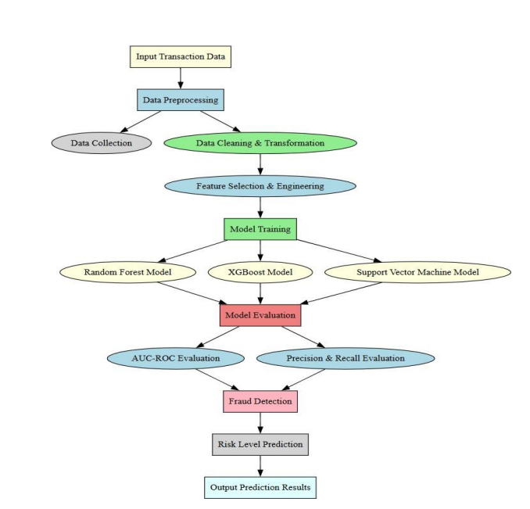
Proposed system

Slide 8
Proposed sytsem
Data Collection: Obtain a labeled dataset of banking transactions, including features like transaction amount, time, location, and user information, with two categories: 'fraudulent' and 'non-fraudulent'.
Data Preprocessing: Clean the dataset, normalize the features, handle missing values, and apply data augmentation techniques such as oversampling or SMOTE for imbalanced data. Feature Extraction: Use techniques like feature engineering to extract relevant features from the transaction data, capturing patterns indicative of fraud. Train/Test Split: Divide the dataset into training, validation, and test sets, ensuring a balanced representation of fraudulent and non-fraudulent transactions. Model Selection: Choose a machine learning model, such as XGBoost, Random Forest for classifying transactions based on the extracted features. Classification: Modify the output layer to handle binary classification: 'fraudulent' (1) and 'non-fraudulent' (0), ensuring the model is trained to differentiate fraudulent activities effectively.

Slide 9
Proposed system
Model Evaluation: Assess performance using accuracy, precision, recall, F1-score, and AUC-ROC on the test set.
Output:
Classification Output: Classify each transaction as either 'fraudulent' or 'non-fraudulent'.
Anomaly Detection Output: Identify and highlight anomalous patterns or suspicious transactions for further investigation.
Business Impact: Provide financial institutions with an efficient and accurate tool for automated fraud detection, reducing losses and enhancing customer trust.

Slide 10
Objective
Develop a machine learning model to accurately identify fraudulent transactions from banking data based on transaction characteristics and patterns.
Collect and prepare a labeled dataset of banking transactions, including both fraudulent and non-fraudulent transactions, with features such as transaction amount, time, location, and user behavior.
Preprocess the transaction data, including normalization, encoding categorical variables, handling missing values, and applying techniques like SMOTE or oversampling to address data imbalance, followed by exploratory data analysis (EDA).
Evaluate the model’s performance using metrics such as accuracy, precision, recall, F1-score, and Area Under the Receiver Operating Characteristic Curve (AUC-ROC).
Improve the model’s accuracy, speed, and robustness by tuning hyperparameters, using ensemble methods, and minimizing overfitting through techniques like regularization and cross-validation.
Test the model on unseen transactional data and compare its performance with existing fraud detection methods to ensure practical applicability and reliability.

Slide 11
APPLICATIONS
Early Detection: Enables the timely identification of fraudulent transactions, reducing financial losses and mitigating risks to both customers and institutions.
Enhanced Security: Assists banking and financial institutions in improving security by providing automated and reliable fraud detection and classification.
Risk Management: Helps in developing effective risk mitigation strategies by identifying fraudulent patterns and anomalies in real-time
Transaction Monitoring: Allows continuous monitoring of transactions over time, identifying suspicious activity and ensuring compliance with regulatory requirements.
Customized Fraud Prevention: Supports personalized fraud prevention strategies by analyzing user behavior and transaction characteristics to detect unusual activity.
Customer Protection: Minimizes the impact of fraud on customers by identifying and preventing fraudulent activities before they escalate.
Financial Research: Contributes to the development of advanced fraud detection methods by providing insights into transactional patterns and fraud characteristics.
Automated Reporting: Reduces the workload of analysts by automatically generating fraud detection reports, improving efficiency and minimizing human error

Slide 12
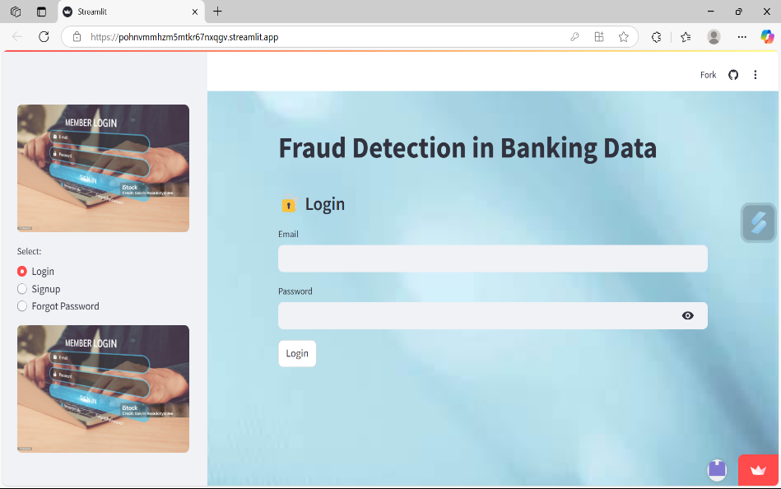
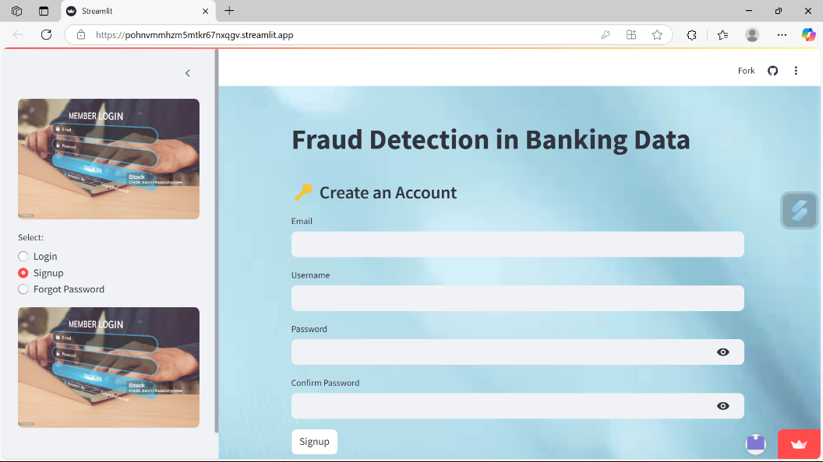
EXECUTION

Slide 13
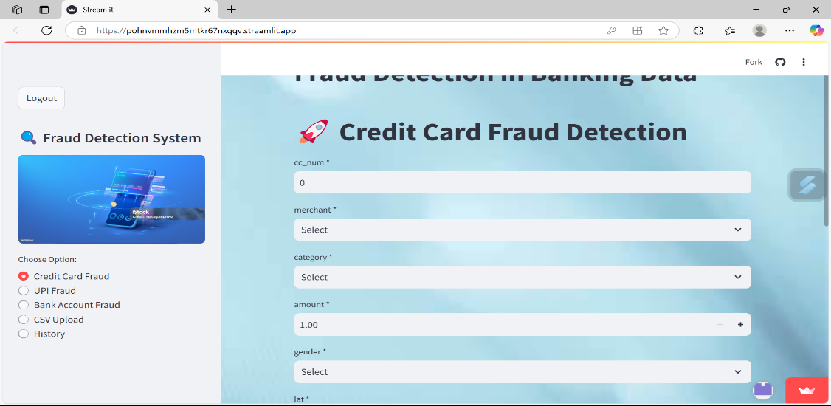
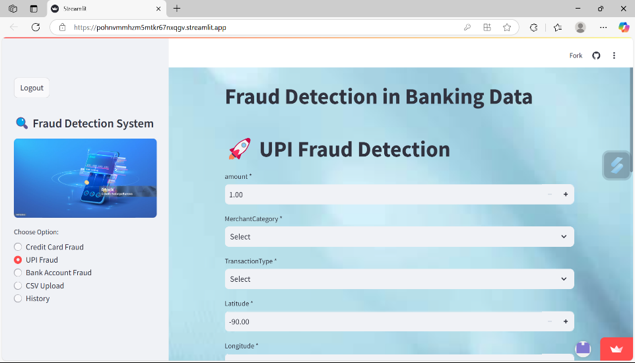
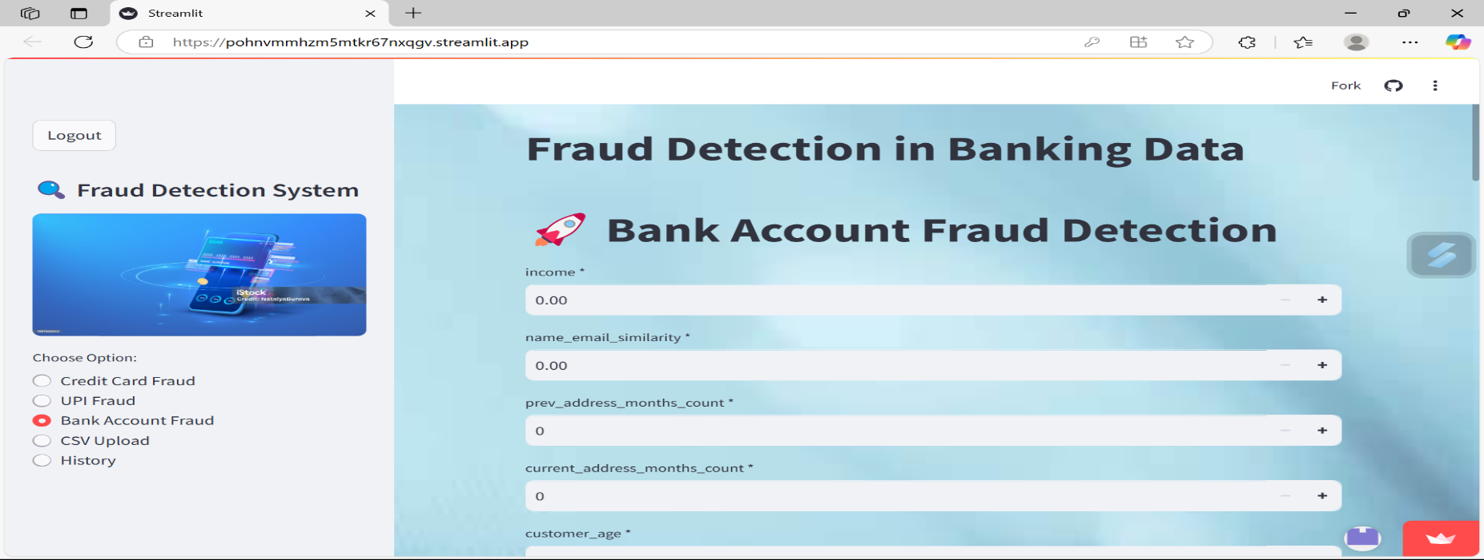
FEATURES

Slide 14
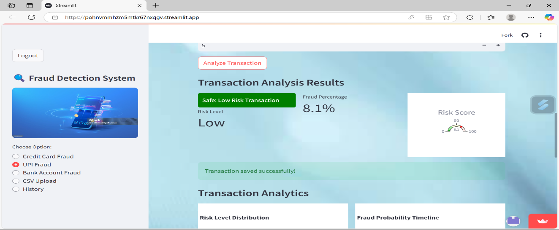
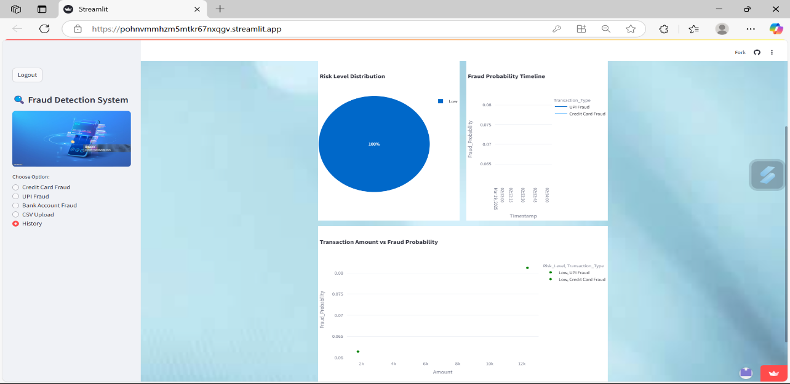

Slide 15
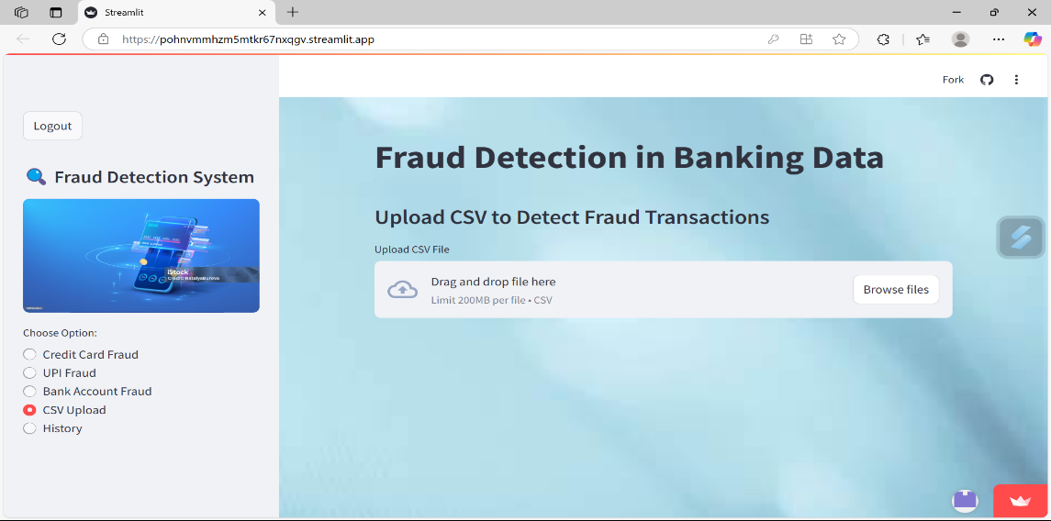
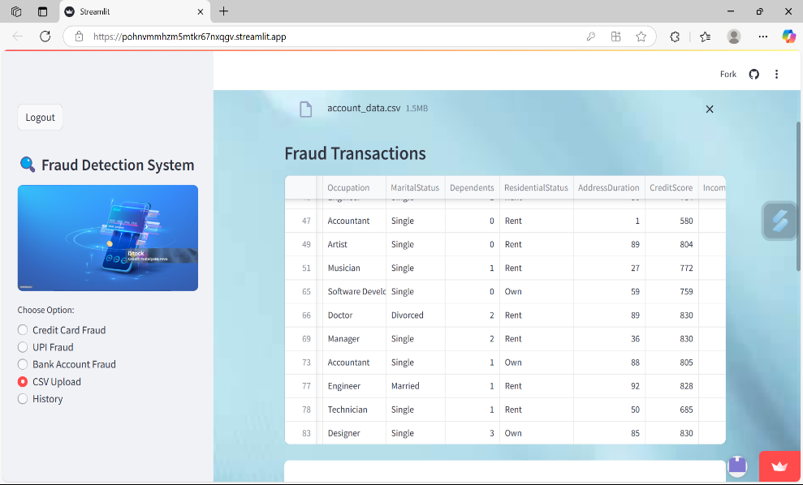
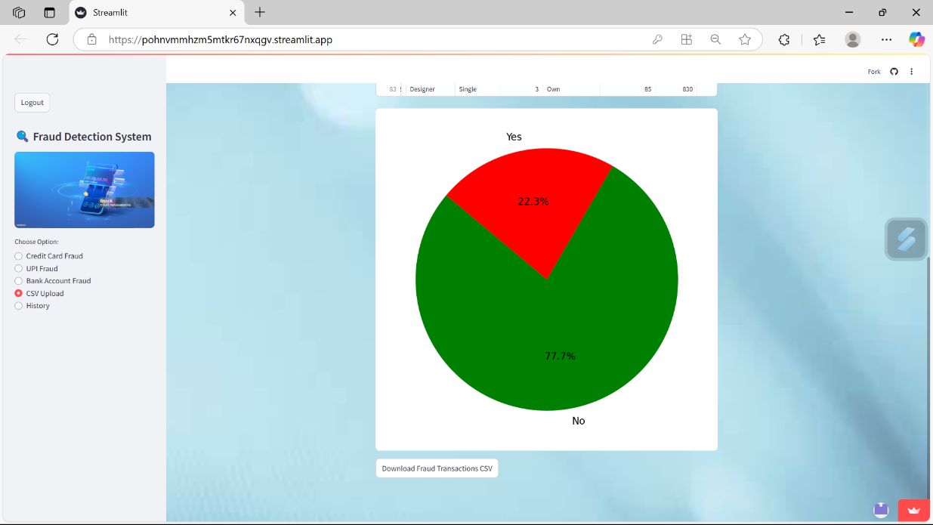

Slide 16
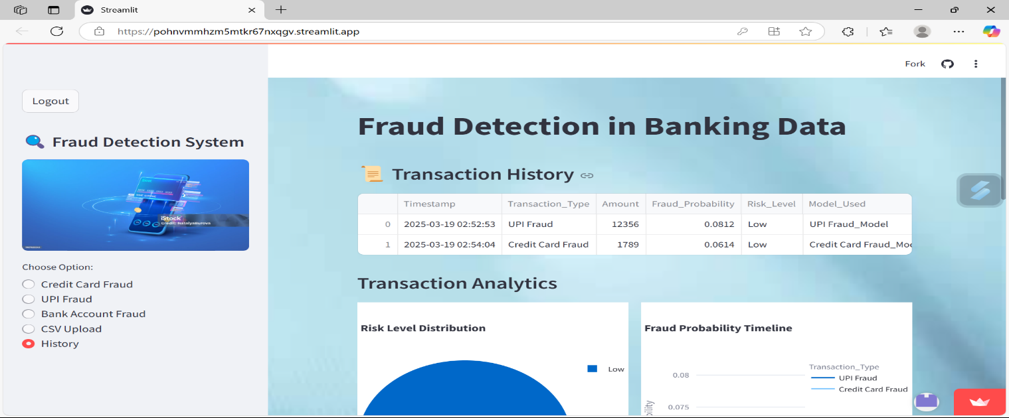


Slide 17
CONCLUSION
The Fraud Detection in Banking Data project offers a practical, intelligent, and secure approach to identifying fraudulent activities in financial transactions. By leveraging machine learning and real-time analytics, the system ensures high accuracy, fast detection, and broad applicability across banking platforms. The project reduces manual oversight, strengthens user security, and delivers meaningful insights through an intuitive web application. It serves as a reliable tool for individuals and small businesses to prevent financial fraud and maintain trust in digital banking systems.

Slide 18
THANK YOU

